Slide 1
Virtualization , libvirt, Qemu-KVM, VM
-IRSHAD

Slide 2
Agenda
Virtualization
Hypervisor
libvirt
Qemu
KVM
Qemu-KVM
Creating Virtual-Machine

Slide 3
Virtualization
Virtualization is a framework or methodology of dividing the resources of a computer into multiple execution environments.
The main reason people are moving to virtualization is effective utilization of resources.
By virtualizing the machine, we are able to run several operating systems at the same time.

Slide 4
A VMM (Virtual Machine Monitor) also called Hypervisor is a piece of computer software responsible for creating, monitoring and enforcing policy on the virtual machines.
This means that the VMM keeps track of everything happening inside of a virtual machine, and when necessary provides resources, redirects the virtual machine to resources, or denies access to resources.

Slide 5
Need of Virtualization:
Availability: temporary migration, if physical node is down.
Scalability: very easy to insert a physical node.
Hardware utilization: virtual machines utilize hardware resources that are left idle.
Security: Using multiple virtual machines, it is possible to separate services by running one service on each virtual machine.

Slide 6
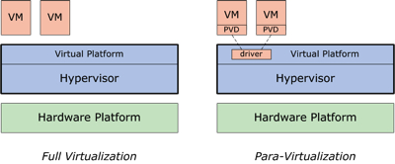
Virtualization Types:
Full virtualization: Where your hardware completely supports virtualization. We no need to modify any specific software or hardware to make your VM’s work properly. Example: KVM, Vmware etc.
Para-virtualization: This type of virtualization is implemented where your Hardware is not at all supported. By using para-virtualization we have to create domains so that VM works in simulated environment with out direct interaction of actual hardware. Example: XEN.

Slide 7
Hypervisor
In virtualization technology, Hypervisor is a software program that manages multiple operating systems on a single computer system.
A computer on which a hypervisor is running one or more virtual machines is defined as a Host machine. Each virtual machine is called a Guest machine.
Types of Hypervisor:
Type-1 Hypervisor also called native or bare-metal hypervisors:
These hypervisors run directly on the host's hardware to control the hardware and to manage guest operating systems.
Type-2 Hypervisor also called hosted hypervisors:
These hypervisors run on a conventional operating system just as other computer programs do.

Slide 8
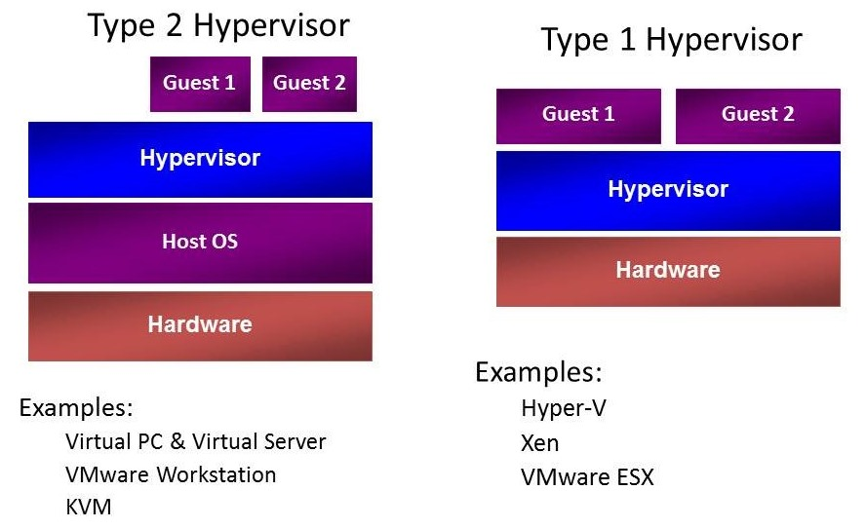

Slide 9
libvirt
Libvirt is a collection of API software that provides a convenient way to manage virtual machines and other virtualization functionality, such as storage and network interface management. These software pieces include an API library, a daemon (libvirtd), and a command line utility (virsh).
A primary goal of libvirt is to provide a single way to manage multiple different virtualization hypervisors.
For example, the command ‘sudo virsh list --all' can be used to list the existing virtual machines for any supported hypervisor. No need to learn the hypervisor specific tools!

Slide 10
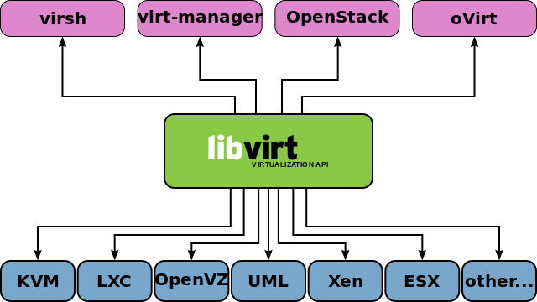
It can be used to manage KVM, Xen, VMware ESX, QEMU and other virtualization technologies.

Slide 11
Qemu
QEMU(Quick Emulator) is a generic and open source machine emulator and virtualizer.
When used as a machine emulator, QEMU can run OSes and programs made for one machine (e.g. an ARM board) on a different machine (e.g. x86).
When used as a virtualizer, QEMU achieves near native performances by executing the guest code directly on the host CPU. QEMU supports virtualization when executing under the Xen hypervisor or using the KVM kernel module in Linux. When using KVM, QEMU can virtualize x86 system.

Slide 12
Configuring Qemu
Source Code can be download from github:
git clone git://git.qemu-project.org/qemu.git
Downloading Qemu:
wget http://wiki.qemu-project.org/download/qemu-2.3.0-rc2.tar.bz2 (April 2nd, 2015)
# tar xfj /qemu-2.3.0-rc2.tar.bz2
# cd qemu-2.3.0
# ./configure && make qemu-img

Slide 13
KVM
KVM(Kernel-based Virtual Machine), is also open source hypervisor built into the Linux kernel, a full virtualization solution for Linux on x86 hardware.
Using KVM, one can run multiple virtual machines running unmodified GNU/Linux, Windows, or any other operating system.
Each virtual machine has private virtualized hardware: a network card, disk, graphics card, etc.
KVM requires that the virtual machine host's processor has virtualization support and we can check it by using the below command:
$ egrep -c 'vmx' /proc/cpuinfo
It will return >0 if your hardware supports the virtualization.

Slide 14
Configuring KVM
Downloading the KVM:
http://downloads.sourceforge.net/kvm/kvm-17.tar.gz
OR,
sudo apt-get install kvm

Slide 15
Qemu-KVM
The KVM project is maintaining a fork of QEMU called qemu-kvm.
When working Qemu with KVM together, KVM decides access to the CPU and memory, and QEMU emulates the hardware resources (hard disk, video, USB, etc.).
If you want a VM with 2 or 4 cores, qemu-kvm creates 2 or 4 threads, each of them calls the KVM kernel module to start executing.
URL for source code: git://git.kernel.org/pub/scm/virt/kvm/qemu-kvm.git

Slide 16
Configuring Qemu-KVM
First ensure that the hardware is supporting the virtualization.
“Virtualization Technology” should be “Enabled” in BIOS.
And to verify it using terminal, execute the below command-
# egrep -c 'vmx' /proc/cpuinfo
It will return >0 if your hardware supports the virtualization.
Installing the Qemu-KVM:
# sudo apt-get install qemu-kvm

Slide 17
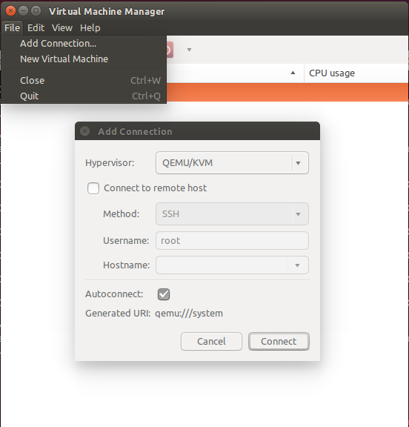
Creating Virtual Machine
Steps to create the VM-
Installing the virt-manager:
# sudo apt-get install virt-manager
Starting the Virtual Machine Manager-
# sudo virt-manager
Create the connection with Hypervisor-
File->Add Connection..

Slide 18
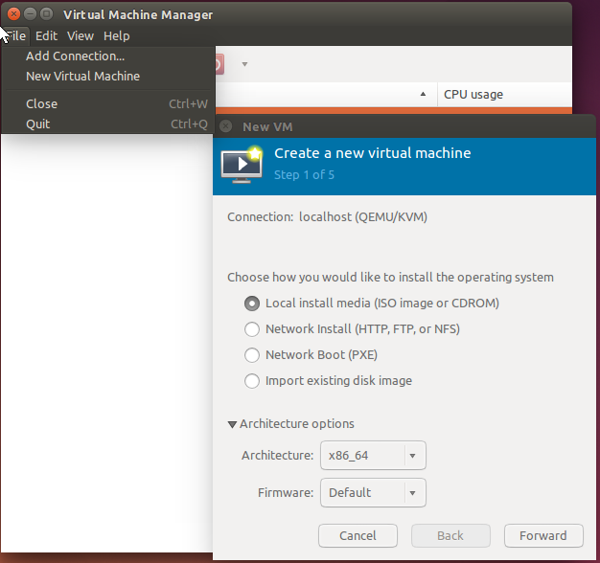
4. Creating a new VM: File-> New Virtual Machine

Slide 19
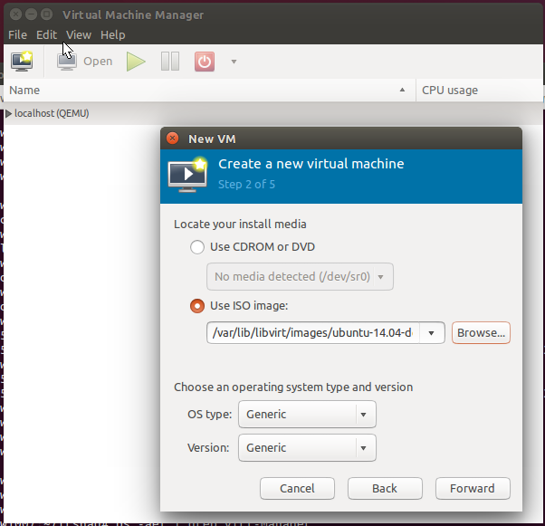
5. Specify the ISO image with complete path:

Slide 20
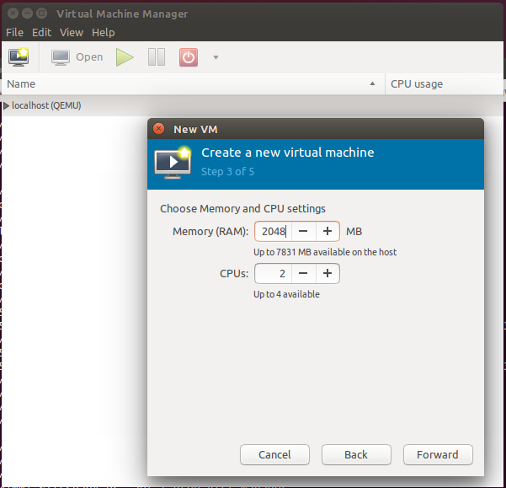
6. Specify the RAM and number of CPUs:

Slide 21
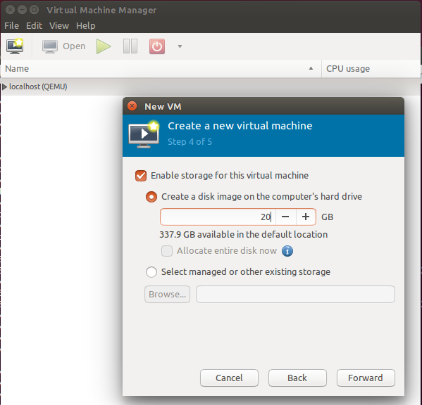
7. Specify the disk space in GB:

Slide 22
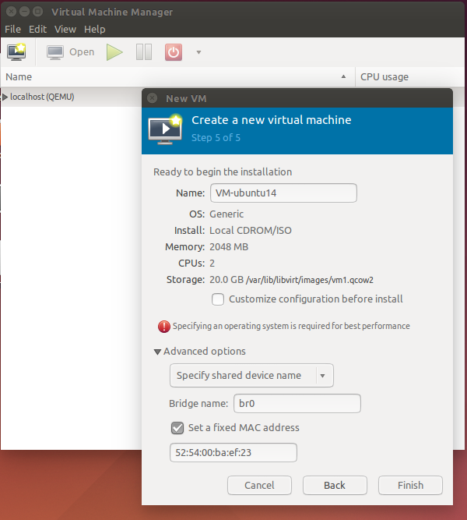
8. Specify name of the VM and in the “Advanced options” please select the network type to connect with host and public network.

Slide 23
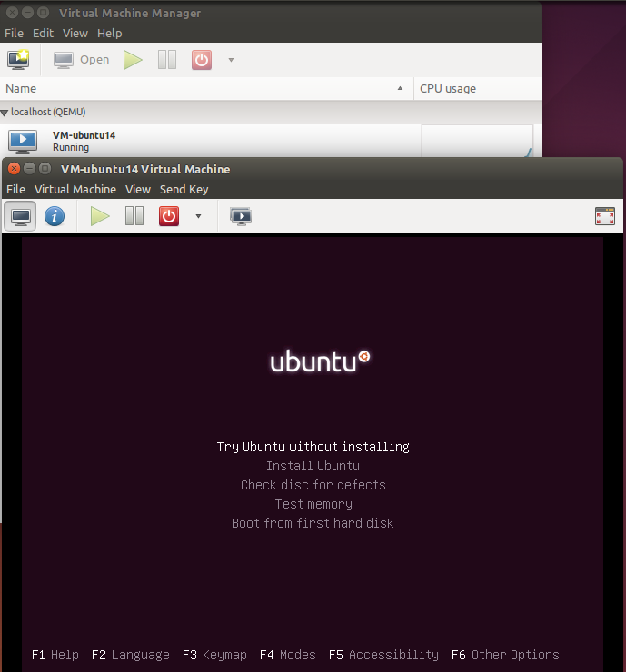
9. After clicking the Finish button ubuntu installation will start in a new window.

Slide 24
Questions?

Slide 25


Thank you.
Headquarters
303 Twin Dolphin Drive 6th Floor Redwood City, CA 94065 USA
Tel: +1 650 632 4310 Fax: +1 650 551 9901
APAC HQ
Plot 31, Electronic City Sector 18 Gurgaon, Haryana 122015 India
Tel: +91 124 4095888 Fax: +91 124 2455100
Europe HQ
Intec 4, Wade Road, Basingstoke, Hampshire RG24 8NE, United Kingdom
Tel: +44 1256 339500

